Slide 1
Unit 6
MSI and LSI Design

Slide 2
Introduction to Integration technology
SSI(Small Scale Integration):
No. of gates = up to 10.
Ex: logic gates (AND, OR, NAND, NOR), 74XX series 4XX series (7400)
2. MSI(Medium Scale Integration):
No. of gates = 10 to 100
Ex: flip-flops, adder, counters, MUX/ DEUX, Encoder, Decoder, 74XXX and 45XXX series.
3. LSI(Large Scale Integration):
No. of gates = 100 - 10,000
Ex: Programmable Logic Array ( PLA ),ROM etc
4. VLSI (Very Large Scale Integration )
No. of gates = 10,000 – 1,00,000
Ex: Complex Programmable Logic Device.

Slide 3
Binary Adder and Subtractor
Binary Parallel Adder (BPA)
produces the arithmetic sum of two binary numbers.
consists of full adders connected in cascade, with the output carry from one full adder connected to the input carry of the next full adder.
‘n’ bit parallel adder requires ‘n’ full adders.

Slide 4
4-bit binary parallel adder
4-bit binary parallel adder requires 4 full adders.
A
3
A
2
A
1
A
0
+
B
B
B
B
3
2
1
0
C
4
S
3
S
2
S
1
S
0
A
3
B
3
A
2
B
2
A
1
B
1
A
0
B
0
C
0
=
0
C
i
n
C
i
n
C
i
n
C
i
n
FA3
FA2
FA1
FA0
C
o
u
t
Σ
C
o
u
t
Σ
C
o
u
t
Σ
C
o
u
t
Σ
C
S
C
3
S
C
2
S
C
1
S
4
3
2
1
0
Fig: 4-bit binary parallel adder

Slide 5
Working of Parallel Adder
Full adder FA0 adds A0 and B0 along with the carry C0 (=0) to generate the sum S0 and the carry C1 which is connected to the next adder in chain.
Then, the full adder FA1 uses this carry bit C1 to add with the input bits A1 and B1 to generate the sum S1 and the carry C2 which is again further connected to the next adder in chain and so on.
The process continues till the last full adder FA3 uses the carry bit C3 to add with its input A3 and B3 to generate the last bit of the output along last carry bit C4.

Slide 6
4-bit parallel subtractor
Subtraction is carried out using 2’s complement
The number to be subtracted (B) is first passed through inverters to obtain its 1’s complement.
Then 1 is added to 1’s complement of B , by making C0=1, to obtain 2’s complement of B.
The 4 bit adder adds A and 2’s complement of B to produce the subtraction.
S3S2S1S0 represents the result of binary subtraction(A-B).
C4 represents the polarity of result
If A>B then C4=1, the result is in true binary form
If A<B then C4=0, the result is in 2’s complement form

Slide 7
Controlled Inverter
When invert is LOW, it transmits the input to the output.
When invert is HIGH, it transmits the 1’s complement of the input.
With a controlled inverter, we can produce a 1’s complement.
Invert | A | F
0 | 0 | 0 (F = A)
0 | 1 | 1 (F = A)
1 | 0 | 1 (F = Ā )
1 | 1 | 0 (F = Ā)

Slide 8
4 bit Binary Adder/Subtractor
A binary adder-subtractor is a combinational circuit that performs the arithmetic operations of addition and subtraction with binary numbers in same circuit.
      Fig: 4-bit adder/subtractor
A
3
B
A
B
A
1
A
o
3
2
2
B
1
B
o
Mode select (M)
C4
F
A3
C
A
F
A2
F
A0
i
F
A1
n
S
S
S
S
1
0
3
2

Slide 9
Binary Adder/Subtractor
When Mode Select(M) = 0 (Low); Co=0, the circuit performs the addition.
The binary numbers B₃ to B₀ passes through the controlled inverter with no change.
The full adders then produce the correct output sum as
 |  |  |  | 0←M
 | A₃ | A₂ | A₁ | A₀
+ | B₃ | B₂ | B₁ | B₀
C4 | S₃ | S₂ | S₁ | S₀

Slide 10
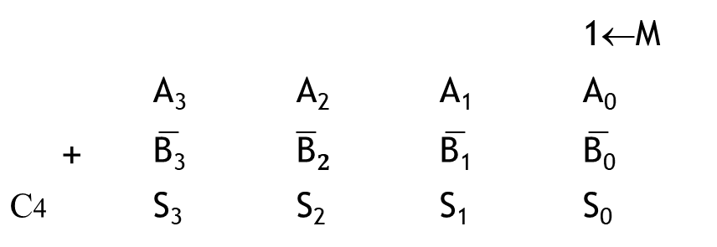
Binary Adder/Subtractor
When Mode Select (M) = 1(High), Co=1, the circuit performs the subtraction.
The controlled inverter produces 1’s complement of B₀ to B₃.
M is the carry into the first full adder (i.e. 1’s complement +1 = 2’s complement).
 |  |  |  | 1←M
 | A₃ | A₂ | A₁ | A₀
+ | $$\overline{\text{B}\text{3}}$$ | $$\overline{\text{B}}2$$ | $$\overline{\text{B}\text{1}}$$ | $$\overline{\text{B}\text{0}}$$
C4 | S₃ | S₂ | S₁ | S₀

Slide 11
Magnitude comparator
compares the two n-bit numbers.
has three outputs: Greater, G (A > B), Lesser ,L (A<B) and
Equal, E (A = B)
Fig: Block diagram of an n-bit comparator
G
r
e
a
t
e
r
(
A
>
B
)
=
G
n
b
i
t
A
n
b
i
t
E
q
u
a
l
(
A
=
B
)
=
E
c
o
m
p
a
r
a
t
o
r
n
b
i
t
B
L
e
s
s
e
r
(
A
<
B
)
=
L

Slide 12

1 bit Magnitude Comparator
Fig: Block diagram of 1-bit
Magnitude comparator Truth Table
G = A $\overline{B}$
E = A⊙B
L = Ā B
Fig: Logic diagram of 1-bit magnitude comparator
A
A
B
G
E
L
G
1 bit
Magnitude
Comparator
0
0
0
1
0
E
0
1
0
0
1
B
L
1
0
1
0
0
1
1
0
1
0
A
B
G
E
L

Slide 13
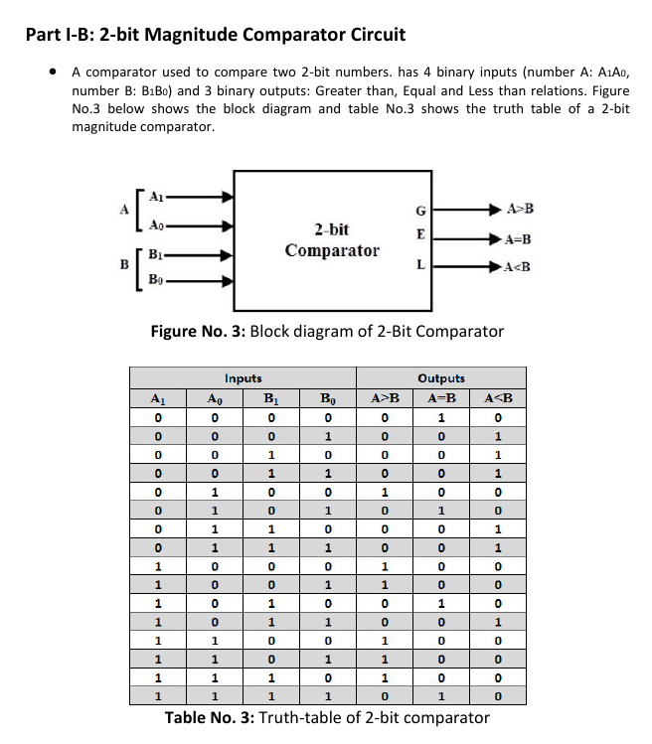
2 bit Magnitude Comparator
Let A=A1A0 and B=B1B0 are two numbers to be compared and G(Greater), L(Less)and E(Equal) are three outputs.
Block diagram of 2-bit Magnitude Comparator

Slide 14
Truth Table
Inputs |  | Outputs
A₁ A₀ | B₁ B₀ | G | E | L
0 0 0 0 0 0 0 0 0 1 0 1 0 1 0 1 1 0 1 0 1 0 1 0 1 1 1 1 1 1 1 1 | 0 0 0 1 1 0 1 1 0 0 0 1 1 0 1 1 0 0 0 1 1 0 1 1 0 0 0 1 1 0 1 1 | 0 0 0 0 1 0 0 0 1 1 0 0 1 1 1 0 | 1 0 0 0 0 1 0 0 0 0 1 0 0 0 0 1 | 0 1 1 1 0 0 1 1 0 0 0 1 0 0 0 0

Slide 15
F
o
r
G
(
A
>
B
)
,
F
o
r
,
E
(
A
=
B
)
B
1
B
0
A
1
A
0
0
0
0
1
1
1
1
0
0
0
0
0
0
0
1
0
0
0
0
1
1
0
0
0
1
1
1
1
0
1
0
1
0
0
1
0
1
1
0
0
0
0
1
0
A
=
D
2
+
D
3
0
0
0
1
G
= A
––
––
––
––
1
B
1
+
A
0
B
1
B
0
+A
A
B
1
0
0
= A
––
––
––
1
B
1
+ A
B
(
B
+ A
)
0
0
1
1
F
o
r
L
(A<B),
0
1
1
1
0
0
1
1
0
0
0
0
0
0
1
0

Slide 16
2 bit Magnitude Comparator

Slide 17
Decoder
A decoder is a combinational circuit that convert binary information from n input lines to a maximum of 2^{n} unique output lines.
Fig: Block diagram of n:m decoder
i
n
p
u
t
n
:
n
:
m
d
e
c
o
d
e
r
m
=
2
n
o
u
t
p
u
t
s

Slide 18

2:4 Decoder
Let A,B are two inputs and
D0, D1, D2, D3 are four outputs
of 2:4 decoder.
Fig: Block diagram of a 2:4 decoder
Truth Table
A
D0
2
:
4
D1
d
e
c
o
d
e
r
D2
B
D3
A
B
Input |  | Output
A | B | D₀ | D₁ | D₂ | D₃
0 | 0 | 1 | 0 | 0 | 0
0 | 1 | 0 | 1 | 0 | 0
1 | 0 | 0 | 0 | 1 | 0
1 | 1 | 0 | 0 | 0 | 1
D0= $\overline{A} \overline{B}$
D1= $\overline{A}$B
D2= A $\overline{B}$
D3= A B
D
0
=
A
B
D
1
=
A
B
D
2
=
A
B
D
3
=
A
B
Logic diagram of 2:4 Decoder

Slide 19
3×8 Decoder (Binary to Octal Converter)
4:16 Line Decoder (Binary to Hexadecimal Converter)
BCD to Decimal Decoder

Slide 20
Decoder with Enable
A signal input called a strobe(Enable) is added so that the gates are enabled and decoding take place.
A
D
D
0
2
:
4
D
1
d
e
c
o
d
e
r
2
B
D
3
E
A
B
E
N
Block diagram of 2:4 Decoder with Enable
D
0
Truth Table
D
1
Inputs |  |  | Outputs
EN | A | B | D₀ | D₁ | D₂ | D₃
1 | × | × | 0 | 0 | 0 | 0
0 | 0 | 0 | 1 | 0 | 0 | 0
0 | 0 | 1 | 0 | 1 | 0 | 0
0 | 1 | 0 | 0 | 0 | 1 | 0
0 | 1 | 1 | 0 | 0 | 0 | 1
D
2
D
3
Logic diagram of 2:4 decoder with enable

Slide 21
Construction of a 3 ×8 decoder using 2× 4 decoder
For 3×8 decoder, no. of inputs = 3 (A, B, C), no. of outputs = 8
For 2×4 decoder, no. of inputs = 2 (A, B), no. of outputs = 4
A
B
C
‘
I
’
A | B | C | output | 2 × 4 decoder 'I' when A = 0
0 | 0 | 0 | D₀
0 | 0 | 1 | D₁
0 | 1 | 0 | D₂
0 | 1 | 1 | D₃
1 | 0 | 0 | D₄ | 2 × 4 decoder 'II' when A = 1
1 | 0 | 1 | D₅
1 | 1 | 0 | D₆
1 | 1 | 1 | D₇
D
0
2
D
:
4
1
d
e
D
c
o
d
e
r
2
D
3
E
N
‘
II
’
D
4
2
D
:
4
5
d
e
D
c
o
d
e
r
6
D
7
E
N
Logic diagram of 3X8 decoder using 2X4 decoder

Slide 22
Encoder
An encoder is a combinational circuit that performs the inverse operation of a decoder.
It has 2^{n} inputs only one of which is active and n outputs.
Fig: Block diagram of Encoder
i
n
p
u
t
s
=
2
n
E
n
c
o
d
e
r
n
=
o
u
t
p
u
t
s

Slide 23
4:2 Encoder
Let D0, D1, D2, D3 are four inputs and
A, B are two outputs of 4:2 encoder.
Fig.: Block diagram of 4:2 encoder
Truth Table
Inupts |  |  |  | Outputs
D₀ | D₁ | D₂ | D₃ | A | B
1 | 0 | 0 | 0 | 0 | 0
0 | 1 | 0 | 0 | 0 | 1
0 | 0 | 1 | 0 | 1 | 0
0 | 0 | 0 | 1 | 1 | 1
D
A
D
0
1
4
:
2
D
E
n
c
o
d
e
r
D
2
B
3
F
o
r
,
A
F
o
r
,
B
x
1
x
1
x
1
x
0
0
x
x
x
1
x
x
x
x
x
x
x
x
x
x
x
0
x
x
x
0
x
x
x

Slide 24
D
D
D
D
0
1
2
3
A
B
Logic diagram of 4:2 encoder

Slide 25
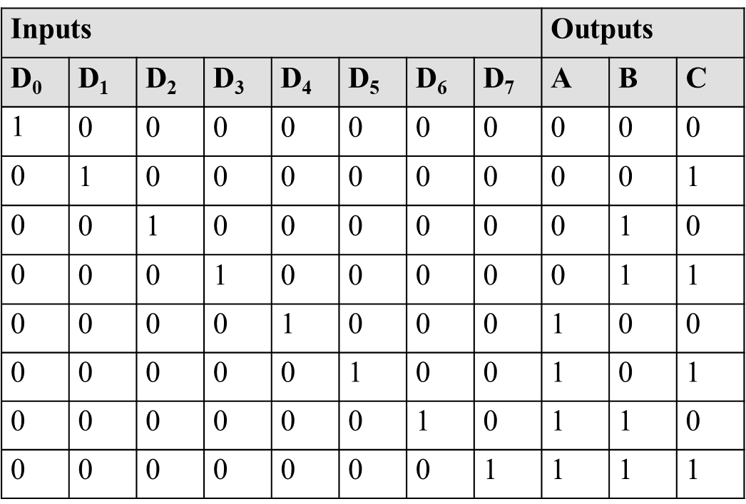
8:3 Encoder(Octal to Binary Converter)
Let D0, D1, D2, D3, D4, D5, D6, D7 are eight inputs and
A, B, C are three outputs of 8:3 encoder.
Truth Table of 8:3 Encoder

Slide 26
A = D₄ + D₅ + D₆ + D₇
B = D₂ + D₃ + D₆ + D₇
C = D₁ + D₃ + D₅ + D₇
D
D
D
D
D
D
D
D
0
1
2
3
4
5
6
7
A
B
C
Fig: Logic diagram of an 8×3 encoder

Slide 27
Limitations of Encoder
Only one input can be enabled at a time. If two inputs are enabled at the same time, then output is undefined.
Priority Encoder
special type of encoder where priorities are given to the input lines.
If two or more input lines are 1 at same time, then the input line with highest priority shall be considered.

Slide 28
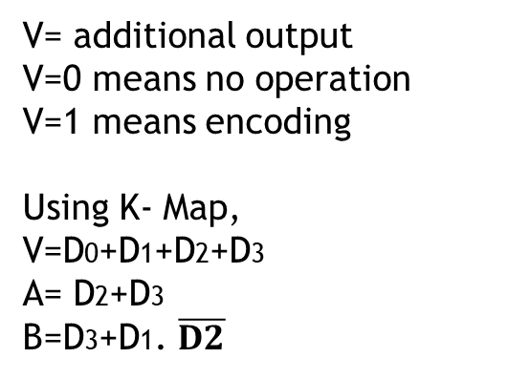
4×2 Priority Encoder
Let D0, D1, D2, D3 are four inputs and A, B are two outputs.
Let D₃ has highest priority and D0 has lowest priority.
L
o
w
e
s
t
p
r
i
o
r
i
t
y
i
n
p
u
t
D0
A
P
r
i
o
r
i
t
D
y
e
n
c
o
d
e
1
r
D
2
B
D
3
g
h
e
s
t
p
r
i
o
r
i
t
Hi
y
i
n
p
u
t
Fig.: Block diagram of a priority encoder
Truth Table:
Inputs |  |  |  | Outputs
D₀ | D₁ | D₂ | D₃ | A | B | V
0 | 0 | 0 | 0 | × | × | 0
1 | 0 | 0 | 0 | 0 | 0 | 1
x | 1 | 0 | 0 | 0 | 1 | 1
x | x | 1 | 0 | 1 | 0 | 1
x | x | x | 1 | 1 | 1 | 1
V= additional output
V=0 means no operation
V=1 means encoding
Using K- Map,
V=D0+D1+D2+D3
A= D2+D3
B=D3+D1. $\overline{D2}$

Slide 29
Multiplexer(Mux/Data selector)
A multiplexer is a combinational circuit which selects single information from multiple inputs one at a time with help of selection line.
For 'n' inputs, there are 'm' selection line and a single output where 2^{m} = n.(Size of Mux= 2^{m} X1 )
D
D
D
0
D
0
D
1
n
D
1
2
:
1
Y
2
Y
M
U
X
D
n
D
-
1
n
-
1
E
S
m
S
S
S
S
S
-
1
0
m
1
-
1
1
0
Fig: Block diagram of a multiplexer

Slide 30
4×1 MUX
D
0
D
1
4
x
1
Y
D
2
M
U
X
D
3
S
1
S
0
Fig: Block diagram of a 4:1 multiplexer
Input |  | Output
S₁ | S₀ | Y
0 | 0 | D0
0 | 1 | D1
1 | 0 | D2
1 | 1 | D3
Truth Table of 4X1 Mux

Slide 31
D
0
D
1
D
2
D
3
S
1
S
0
Y
Fig: Logic diagram of 4:1 MUX

Slide 32
Demultiplexer (De mux or Data Divider)
A demultiplexer is a combinational circuit that receives information on a single input and transmits the same information over one of the possible output lines.
For ‘n’ output, there is ‘m’ selection line and single input where n = 2^{m}
Fig.: Block diagram of a demultiplexer
Y
0
Y
1
D
a
t
a
1
:
n
o
u
t
p
u
t
D
E
M
U
X
Y
n
-
1
S
m
S
S
-
1
1
0

Slide 33
1:4 Demultiplexer
Y
0
1
Y
D
:
4
1
D
E
M
U
X
Fig: Block diagram of a 1:4 demultiplexer
Y
2
Y
3
S
1
S
0
Truth Table
Inputs |  |  | Outputs
D | S₁ | S₀ | Y₀ | Y₁ | Y₂ | Y₃
D | 0 | 0 | D | 0 | 0 | 0
D | 0 | 1 | 0 | D | 0 | 0
D | 1 | 0 | 0 | 0 | D | 0
D | 1 | 1 | 0 | 0 | 0 | D

Slide 34
D
S
1
S
0
Y
0
Y
1
Y
2
Y
3
Fig.: Circuit diagram of a 1:4 demultiplexer

Slide 35
Numerical
Implementation of Boolean functions using Decoder, Multiplexer and Demultiplexer

Slide 36
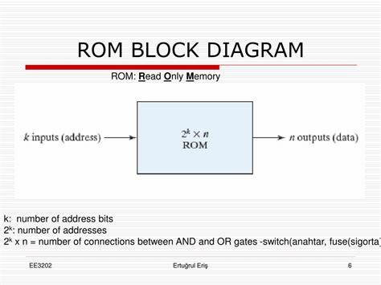
ROM(Read Only Memory)
A ROM is a storage device in which a fixed set of binary information is stored.
Internally, ROM is a combinational circuit with AND gates connected as a decoder and a number of OR gates equal to the number of outputs in a unit.
Block diagram of ROM

Slide 37
Programmable Logic Arrays (PLA)
A PLA consists of set of programmable AND gates, which links to a set of programmable OR array to produce outputs.
PLA does not provide full decoding of the variables and does not generate all min term as in ROM.
In PLA, decoder is replaced by a group of AND gates, each of which can be programmed to generate product term of input variables.
Fig: Block diagram of PLA

Slide 38
End of Unit 6

